Slide 1
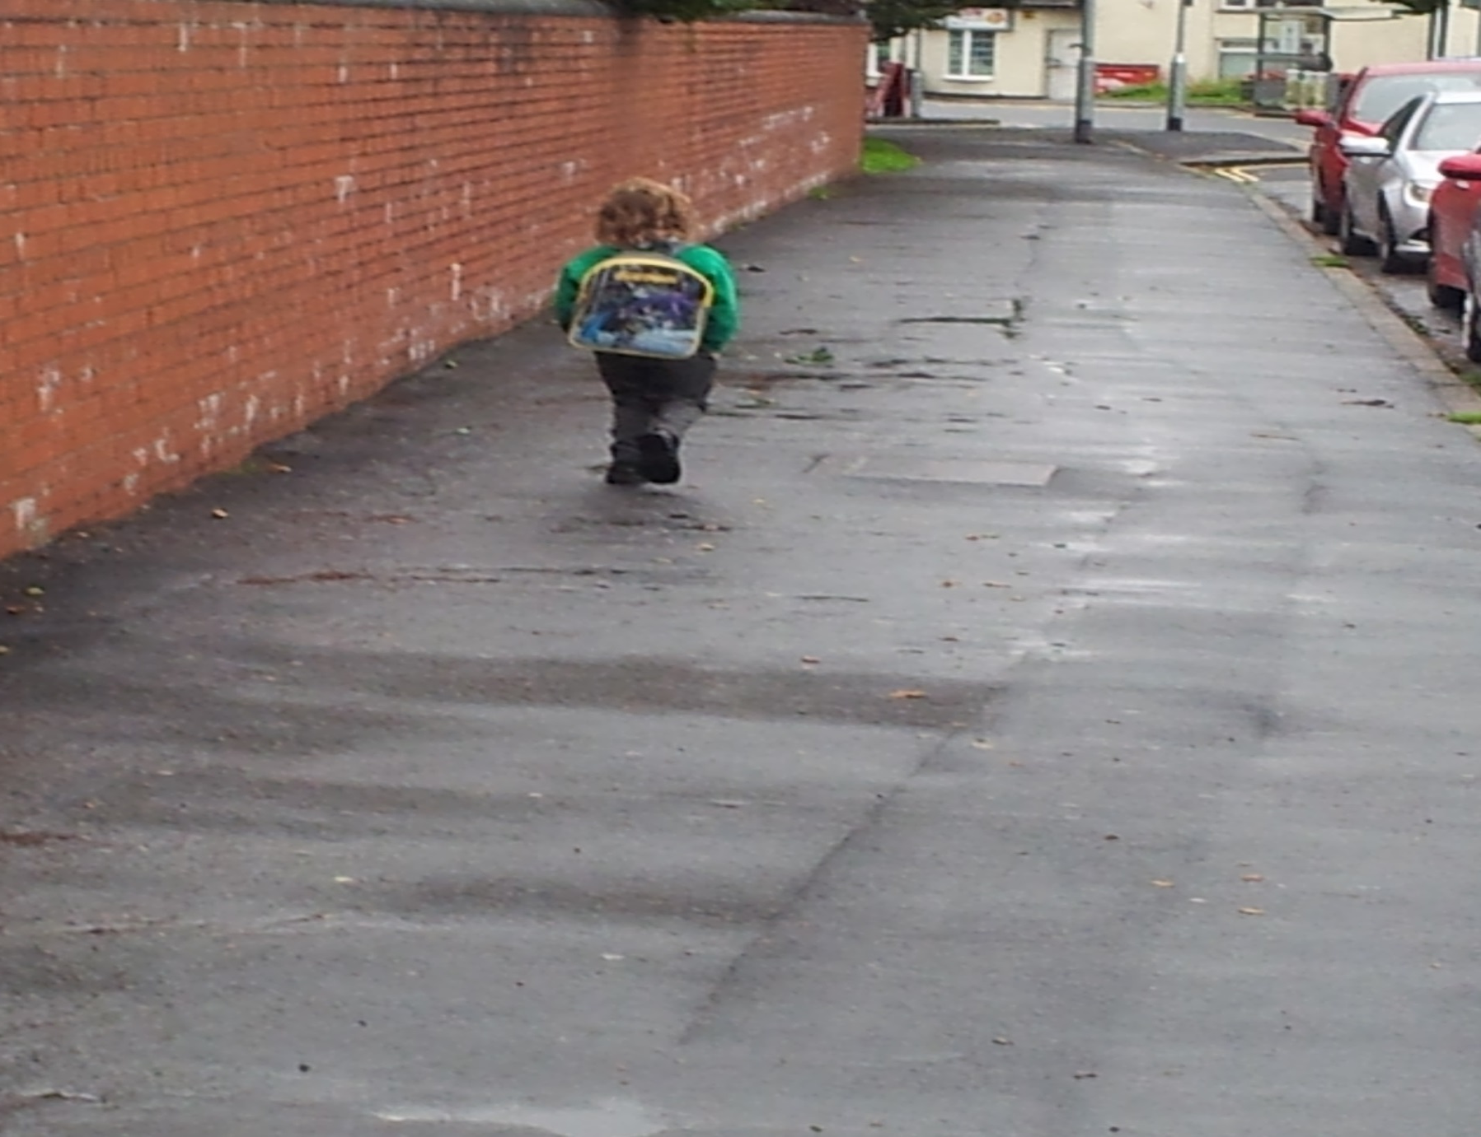
Newport - Autumn 2014: First Day at School… Dad in prison again

Slide 2
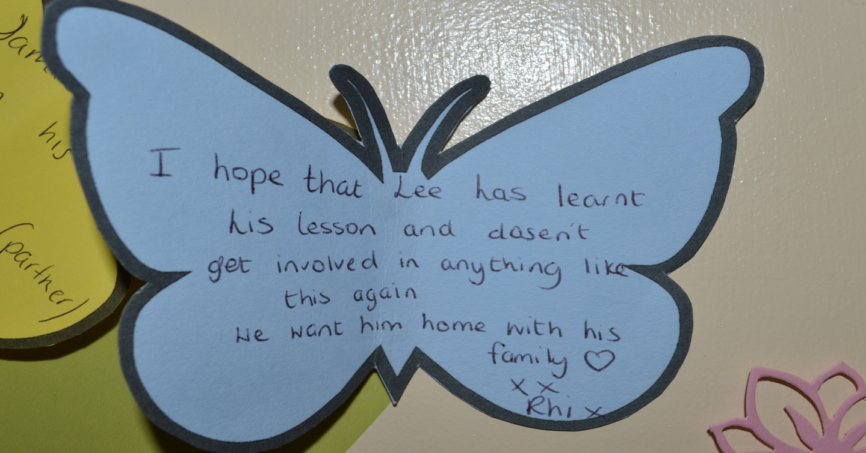
43
72
65
7
Corin Morgan-Armstrong
Head of Family Interventions & Invisible Walls Wales

Slide 3
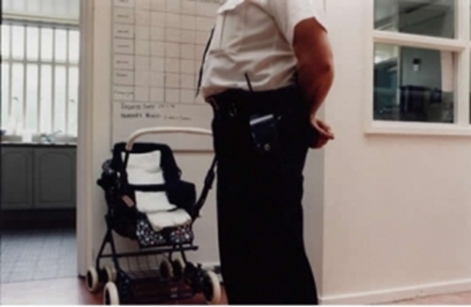
Family Interventions… Reality check:
2015 = 200,000+ children in England and Wales with a parent in prison. This is two and a half times the number of those in care and over six times the number of those on the Child Protection Register.
2014: English & Welsh prison system processes over half a million child visits
In 2006 more children were affected by the imprisonment of a parent than by divorce.
6 out of 10 boys with a convicted parent end up in custody themselves
25% of men in Young Offenders Institutes are, or are shortly to become fathers.
48% of prisoners in Scotland were excluded from school
as children
Failing to help troubled youngsters at an early age costs
17 Billion a year (Feb 2015)
(MOJ 2012/ DfE2003/2007/Prison Reform Trust 2011/SEU2002/PACT/Families Outside2013/
Barnardos-Forgotten Victim 26Sept’2014/Early Intervention Foundation 2015)

Slide 4
Prof’ Ken Reid: 40+ years of research - Welsh Government advisor on Behaviour & Attendance 2014
Majority of absenteeism in the UK (2014) is amongst females.
36% of all absenteeism in the UK is at Primary School level.
The main cause of persistent absenteeism in 85% of cases – cited ‘issues at home’
By the time a 3 year old reaches Secondary school, there is a 70% chance of parental separation/divorce.
When a child with an average of 15 days a year absenteeism, reaches 16 years old, they will be the equivalent of 1 whole school year behind.
80% of young offenders committed the crime they were serving a sentence for, whilst truanting… 70% went on to commit further offences and receive adult prison sentences.

Slide 5
Snapshot of evidence 21+ years…
Prisoners unable to maintain ties between two and six times more likely to re-offend within first year of release when compared to those who do (Ditchfield, 1994)
Social Exclusion Unit report 2002 – ‘Creating and encouraging healthy family contact whilst in custody, can reduce the likelihood of offending by up to 6 times’.
Prisoners who received visits had a significantly lower reoffending rate (52 per cent) than prisoners who received no visits at all (70 per cent) (May et al, 2008)
The MOJ Resettlement Survey 2008 - ‘offenders who had received at least one visit during their time in custody were 39% less likely to re-offend than those who had received no visits’
Criminal Justice Policy Review USA 2011 - A study of 16,000 prisoners over 4 years ‘…found that visits significantly reduced the risk of recidivism’.
‘Improving Prisoners Family Ties’ (New Philanthropic Capital- April 2011-2014) - positive family engagement whilst in custody, amounts to an average financial cost saving, upwards on a scale that starts at 16k per individual per cycle.

Slide 6
‘Majority of prisoners ETE outcomes on release are set up by family and relatives… Prisoners who receive family visits are three times more likely to have housing or accommodation arranged for them upon release when compared to those who had failed to receive any visits at all.’ Niven and Stewart, 2005
“an offender’s family are the most effective resettlement agency.”
September 2014 – HM Criminal Justice Joint Inspection on Resettlement by Prison, Probation & Ofsted Inspectorates

Slide 7
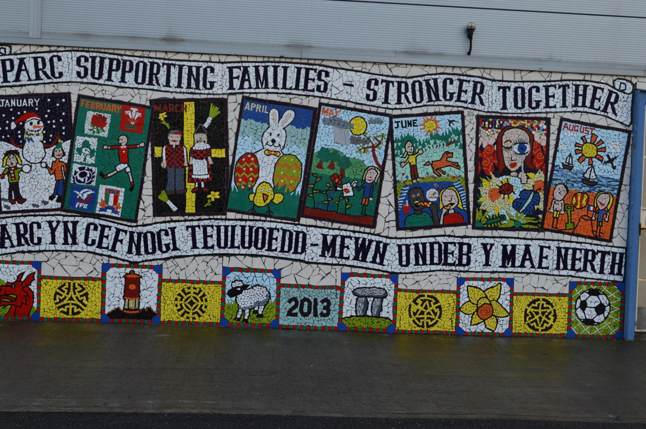
Piece by piece … change begins

Slide 8
The Sacred Flame…
My experience leads me to conclude that the most effective method to engage and motivate offenders, is through a focus on their children and families
This creates a dynamic motivation… The Sacred Flame
The Sacred Flame is an eternal motivation of personal improvement for family & self
The IW model takes The Sacred Flame and amplified it in as many ways as possible, to impact on as many offenders and their families as possible

Slide 9
Family Interventions - Our 3 core aims since 2006
Reducing the risk of reoffending & prison
Reducing the risk of intergenerational offending
Reducing social exclusion of families in their local community

Slide 10
The glass ceiling of prison rehabilitation:
Highest performing prisons in the UK process approximately 10-15% of their population through ‘accredited’ offending behaviour programmes. (MOJ.2011)
“Generally, these interventions have a range of positive but modest outcomes, e.g. in the large meta-analysis of Latimer, Dowden and Morton- Bourgon 2003, there was a 9% reduction across interventions” (Dr M Penman 2013)
“some rehabilitation programs work with some offenders in some settings when applied by some staff.” (Antonowicz and Ross 1994, p. 1)
“. . . the desistance literature has pointed to a range of factors associated with the ending of active involvement in offending. Most of these factors are related to acquiring ‘something’ most commonly a life partner, children or a family, which the desister values in some way and which initiates a re-evaluation of his or her own life . . .”(Farrall 2002: 11)
Lowest performing prisons in the UK provide 48% of their population with regular family visits. (PSO 14)

Slide 11
Prison Visits – ‘The crucible of whole family rehabilitation’
Global corrections evidence base proves the impact visits has on reducing reoffending
Majority of prisoners in the UK receive regular visits
Penology & corrections practice dictates visits as security led
Security led visits limits family engagement opportunities
Culture shift, from security led to interventions led visits
Opportunities released to innovate & maximise whole family engagement
Majority of prisoners (69% Parc) now receive regular opportunity for rehabilitation via interventions led visits
Positive residual impact on intergenerational offending, wider family social exclusion, and reduction in crime costs
This model amplifies the existing proven impact on rehabilitation & intergenerational offending

Slide 12
The Invisible Walls model
Interventions Led Visits
External Partnership Arrangements
Family Intervention Unit

Slide 13
Invisible Walls Wales
Custody & community
Cost saving focus
Evaluation & research
Replication model
BIG Lottery Funded
Partnership
working
Whole family approach
Pre/post release

Slide 14
The Invisible Walls Model is supported by over 40 partners including…
Jigsaw
HMP Cardiff
HMP Swansea

Slide 15
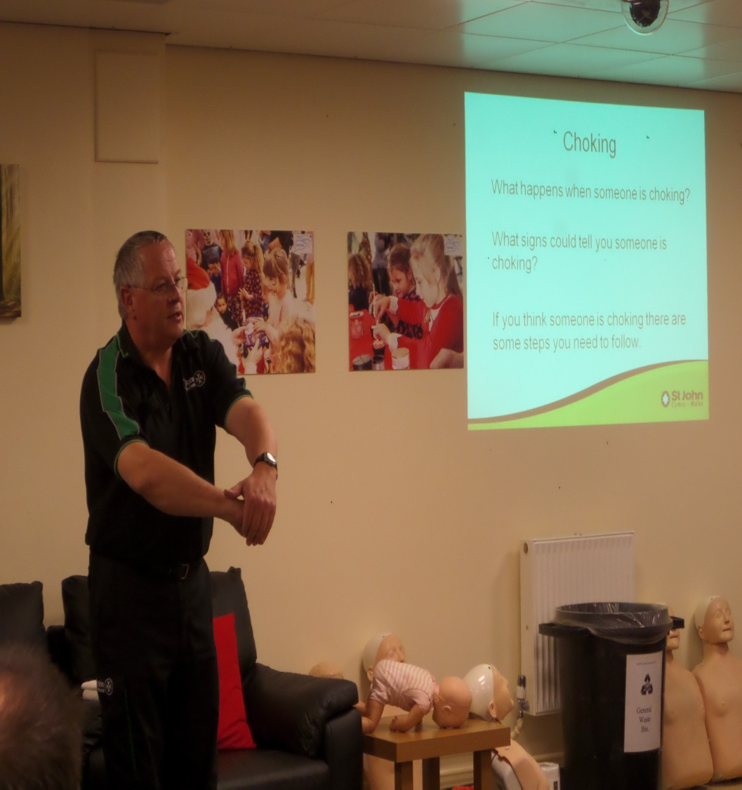
St. John’s Ambulance Family 1st Aid: Founded 2015

Slide 16
IWW model – some outcomes 5 years in.
99% reduction in physical indiscipline in the visits hall.
85% reduction in live visit terminations
82% reduction in drug dog indications on domestic visitors.
Uptake of regular family visits – UK average 48%, HMP Parc 69%
1000+ calls to the family support line per month logged and actioned.
Family Interventions Unit – 375+ Graduates released since Nov 2010 – anecdotal evidence – less than a third have returned to custody. (Data Lab submission pending)
60+ South Wales primary and secondary schools actively engaged through the Invisible Walls Accord.
September 2015 – first & currently only prison in the
EU to have been awarded the ‘Investors In Families’
accredited charter mark.

Slide 17
IWW project
some initial outcomes - start of year 4
95% = of prisoner clients graduated through the Family Intervention Unit element
93% = engagement of partners & extended family to exit.
100% = engagement of child clients to exit.
0% = NFA status for clients at project exit.
29% = increase in secure employment for clients at project exit.
19%= increase for adult clients with education and/or training at project exit.
90% = prisoners at start misusing drugs/alcohol – fell to 24% at project exit.
30% = reduction in child clients at project exit assessed to have school attainment/attendance issues.
91% = of child clients at project exit assessed as now having appropriate peer relationships.
0% = Child clients at project exit assessed as ‘isolated’.
Average school attendance pre IWW = 85.7% Post IWW = 93.1%
Community exit point – statistically significant positive change with all clients, indicating significant improvements in parenting skills and family functioning.
5% = Start of year 4… Current reconviction rate. (all with crimes of a de-escalating severity)

Slide 18
Replication of the IW Model:
Some examples of how and where the core ingredients have been taken on and/or influencing establishments, practice & ethos:
IW Model
HMP Oakwood FIU
HMP Altcourse FIU
HMP Erlestoke FIU
HMP Maghaberry – Northern Ireland FIU
Kampala WoH+ Max Sec’ Prison – Uganda & school
HMP Ryehill
Isle of Man Prison
HMP Birmingham
Netherlands - Hanze Uni + 2 prisons
HMP Norwich ILV
Republic of Ireland Prisons14 prisons ILV
HMP Leicester ILV
Shared with 60+ prisons in 2 years
Maltese Gov’

