Slide 1
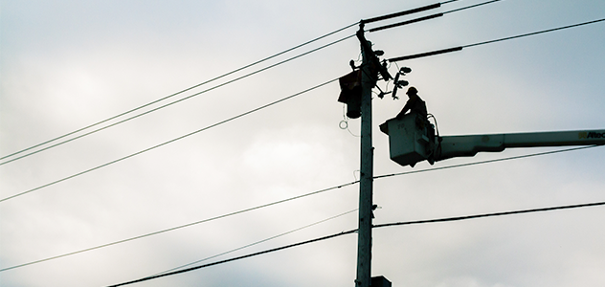
G4S
Openreach PSTN Switchover
SLIDE HELP
TO CHANGE THIS
BACKGROUND IMAGE:
RIGHT CLICK on background
Select CHANGE BACKGROUND > CHOOSE IMAGE
Select the image to use
Note: Images will need to be a ratio of 16x9 so as not to be distorted (Stretched or Squash)
What It Means For You

Slide 2

Contents
What Is The PSTN & ISDN Switchoff?
When Is The PSTN & ISDN Switchoff?
Why Is Openreach Withdrawing PSTN And ISDN?
What Other Lines And Calls Services Are Impacted?
Will Openreach Provide PSTN Replacement Products And Services?
What Will Happen To Alarm Lines And Other Special Line Rental Services?
What Does The 2023 Stop Sell Date Mean?
Will Openreach Meet The December 2025 Deadline?
Your Next Steps

Slide 3
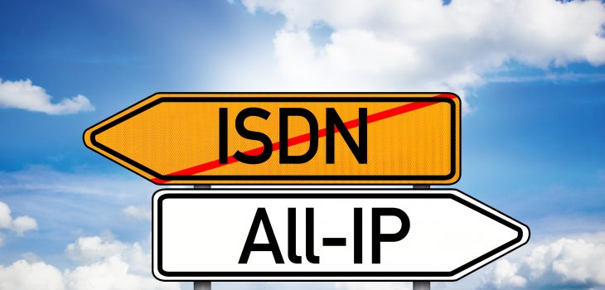
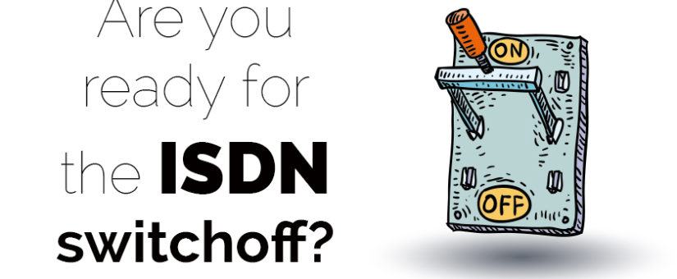
What Is The PSTN & ISDN Switchoff?
Public Switch Telephone Network (PSTN) aging
PSTN supports number of Openreach products through Communication Providers (CPs),
  Wrapped in own line rental, broadband and call package.
    Including: Wholesale Line Rental (WLR) and Integrated Services Digital Network (ISDN).
ISDN available in two common variants:
  ISDN2 supports between 2 and 8 ISDN channels.
  ISDN30 supports larger business customers, with between 8 and 30 ISDN channels.
At end December 2025 fixed lines and services in PSTN will be switched off and withdrawn - to be replaced by “All IP” Digital Network or 4G network

Slide 4


What Is The PSTN & ISDN Switchoff?
Today
WLR
5.5k Voice Lines
Copper
Street Cabinet
Copper
FTTC
FTTP
Fibre
Future
X
WLR
5.5k Voice Lines
Copper
Street Cabinet
Copper
SOGEA/
SOTAP
FTTP
Fibre

Slide 5

When Is The PSTN & ISDN Switchoff?
PSTN & ISDN will be switched off by December 2025
But Phased - When IP has 75% network coverage in area, PSTN/ISDN will be switched off
Nov 2017
2018
Dec 2020
Sep 2023
Dec 2025
BT Announce Intentions To Switch Off PSTN & ISDN By 2025
Openreach Improving Network With Fibre First Strategy,
Five Year Reminder That WLR Will Be Withdrawn
Stop Selling WLR
End Of Life. Target Date By Which All PSTN & ISDN Lines Withdrawn

Slide 6

Why Is PSTN And ISDN Being Withdrawn?
PSTN allows calls over both copper and fibre
  uses analogue signalling - “traditional telephony”.
As broadband service quality increased over past 10 years, no longer need for traditional fixed-analogue services in future.
Future priority for Openreach is to maintain high availability fibre network
  equipment serving PSTN now ageing and difficult to maintain.
Switch to IP means substantially more data can be handled

Slide 7

Which Lines & Services Are Impacted?
PSTN currently supports:
  WLR
  ISDN2
  ISDN30
  Local Loop Unbundling Shared Metallic Path Facilities (LLUSMPF)
  Narrowband Line Share and Classic Products.
And services supported by the above:
  Asymmetrical Digital Subscriber Lines (ADSL) Broadband
  Fibre To The Cabinet (FTTC) Broadband which will be impacted the WLR End of Life project.

Slide 8

Will There Be Replacement Products/Services?
In future, Openreach products will be Single Order (SO) variant of ADSL, or Fibre broadband services.
  Single Order Generic Ethernet Access (SOGEA) which is FTTC replacement.
  Single Order Transition Access Product (SOTAP), which is ADSL replacement - available in areas where fibre isn’t.
New broadband services require new equipment but can be purchased via comms providers.

Slide 9


What Will Happen To Alarm Lines And Other Special Line Rental Services?
During PSTN closure, all services need to be tested with new IP technology and SO products.
Alarm line companies, payphone lines, emergency pendants, telemetry devices and any other special service must be tested by equipment manufacturers.
Openreach can provide line test facilities for testing equipment
Inside premises, only router will connect to master socket - extension sockets will not work

Slide 10

What Does The 2023 Stop Sell Date Mean?
From September 2023, Openreach will issue full “Stop Sell” of new supply WLR.
From September 2023 - no new line installations for both WLR and ISDN, including:
    Conversions of WLR Line to ISDN Line
    Increase of ISDN channels
    Change of address
    Working line take over.
Consumer rights still need to be upheld
  Therefore line transfers will be accepted providing no change to installation when line moves from one provider to another.
All calling and network features, such as caller display, will be allowed.

Slide 11

Will Openreach Meet The December 2025 Deadline?
Openreach are adamant December 2025 deadline is set in stone.
PSTN Lines not migrated to alternatives by April 2025 will be deemed as Orphaned Assets
Openreach will work with CPs to identify and migrate customers to alternative products by December 2025 so they do not lose service.
Services will be withdrawn by December 2025
  But switchoff phased, by exchange, up to then
  Customers will be impacted if do not move in time.

Slide 12

Your Next Steps
Consider alarm services you and your customers use
  Will they work on All IP Network?
  What about power and battery back-up?
  When do you or your customer need to change over? When do you need to act?
  How will identified migrations be performed?
PLAN - There is a lot to do!!
Carry out impact assessment
Talk to comms providers
Keep informed of progress on Openreach website
Talk to G4S - we are here to help

Slide 13

Contact and Links
For more information regarding how G4S can help, please contact:
  Your local G4S account manager or:
  Paul Fitzgerald
    E: paul.fitzgerald@uk.g4s.com
    M: +353 874435830
Useful Links:
  xxxxxxxxx G4S webpage
  redcare.bd.com

