Slide 1
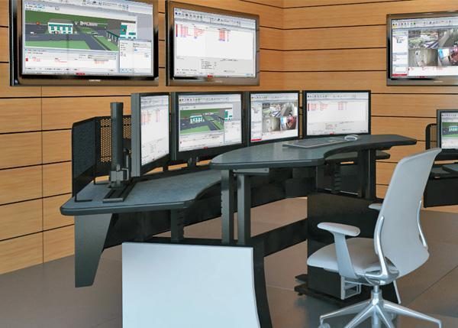
G4S
THE G4S APPROACH
SLIDE HELP
TO CHANGE THIS BACKGROUND IMAGE:
RIGHT CLICK on background
Select CHANGE BACKGROUND > CHOOSE IMAGE
Select the image to use
Note: Images will need to be a ratio of 16x9 so as not to be distorted (Stretched or Squash)

Slide 2
Our Risk Assessed Approach To System Design
SLIDE HELP
UPDATES TO THIS SLIDE
This slide is to represent our Risk Based Approach.
The infographic explains that we take a Risk Based Approach to security discussions, and look at our services (of which our products and solutions sit in), to create the best possible Integrated Security Solution for our customers.
Note: If your market/country has a different way of expressing a Risk Based approach, you may update this slide in line with that.
What Do You Need To Protect?
PEOPLE
SERVICES
What Do You Need To Protect It From?
PROFESSIONAL SERVICES
INTEGRATED SECURITY SOLUTION
How Do You Most Effectively Protect It?
TECHNOLOGY & DATA SERVICES

Slide 3









Why Partner With G4S?
BEST IN CLASS PROVISION DRIVEN BY:
HIGHEST QUALITY SOLUTION DESIGN - SINGLE PLATFORM
PROVEN TRACK RECORD
INNOVATIVE TECHNOLOGY - MEETING BUDGET & PERFORMANCE
HIGHEST SECURITY CLEARANCES
CUSTOMER CARE
STRONG SECTOR EXPERIENCE
STRONG SAFETY CULTURE
PROJECT MANAGEMENT EXCELLENCE
GLOBAL REACH
Notes:
Best in class provision driven by:
Integration of technology from multiple vendors to single source - simple accountability for delivery
Experience selecting best technology to meet budget and performance
Proven track record of successful project delivery
Proven track record of delivering to tight deadlines and highest security clearance
Unrivalled global presence to replicate systems across multiple geographies
Commitment to use Suitably Qualified and Experienced Person (SQEP) to design, install, test systems
Strong safety culture with well-defined safe systems of work (SSOW)

Slide 4









OUR APPROVALS
ISO CERTIFICATIONS
NSI GOLD (ISO9001)
NSI FIRE GOLD (ISO9001)
BAFE SP203-1
NSI ISO 14001 (SSUK)
NSI ISO 18001 (SSUK)
SSIP CERTIFICATIONS
SAFE Contractor
Achilles
Contractor Plus
We pride ourselves in delivering high quality work to exacting standards. Our work, processes and procedures are rigorously externally audited and follow best practices for our industry
OUR APPROVALS INCLUDE
Security
Fire

Slide 5
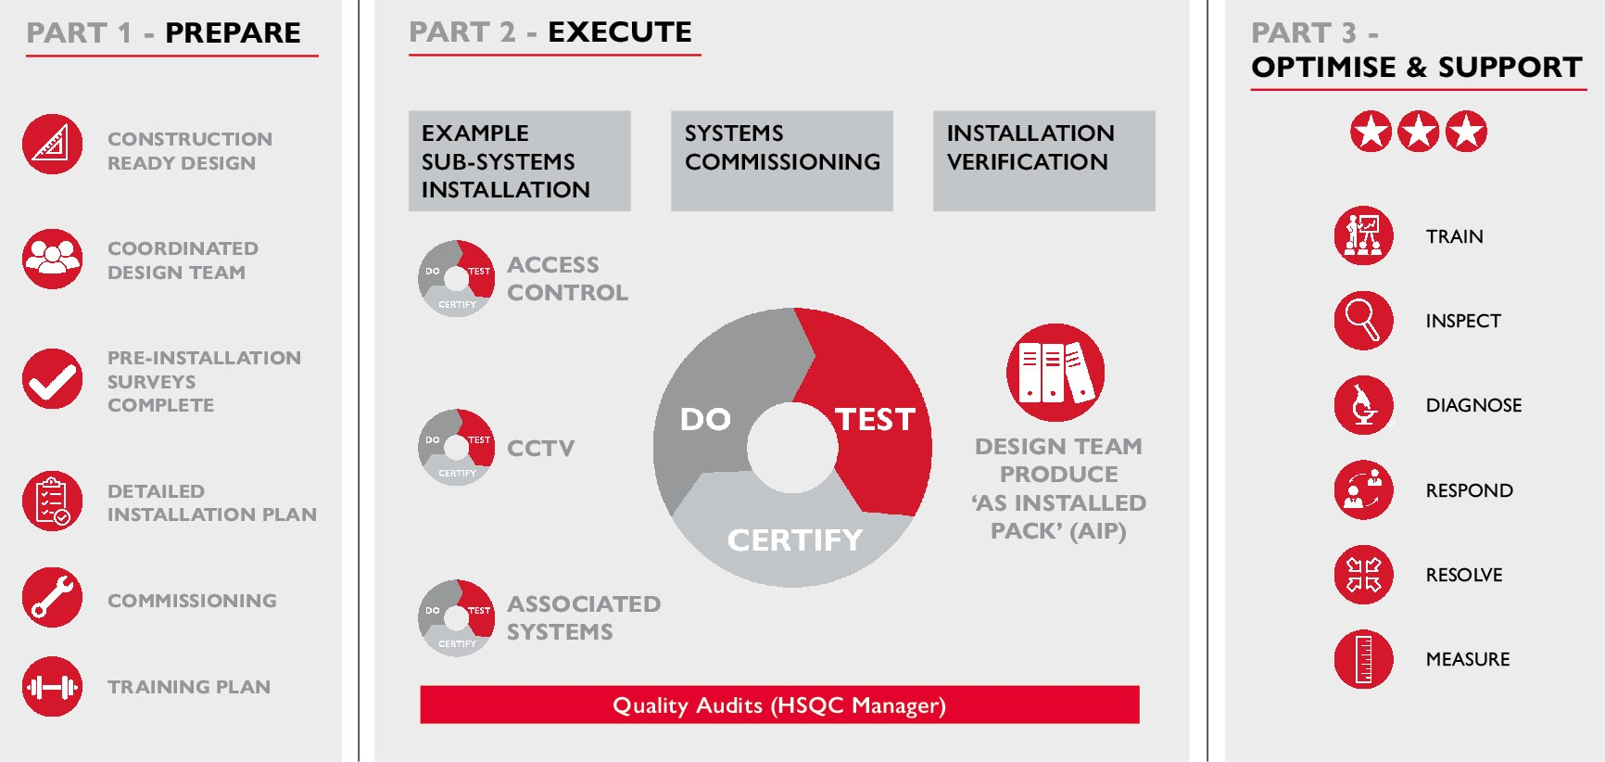
Our Approach To Projects

Slide 6
After Sales Support Options
After Sales Support
Maintenance Support
Remote Monitoring
G4S Academy

Slide 7


G4S Maintenance Support
SLIDE HELP
TO CHANGE THIS BACKGROUND IMAGE:
RIGHT CLICK on background
Select CHANGE BACKGROUND > CHOOSE IMAGE
Select the image to use
Note: Images will need to be a ratio of 16x9 so as not to be distorted (Stretched or Squash)
SITES SUPPORTED
3,500
ENGINEERS
151
RESPONSE WITHIN
CONTRACTED SLA
91%
FIRST TIME
FIX
92%

Slide 8
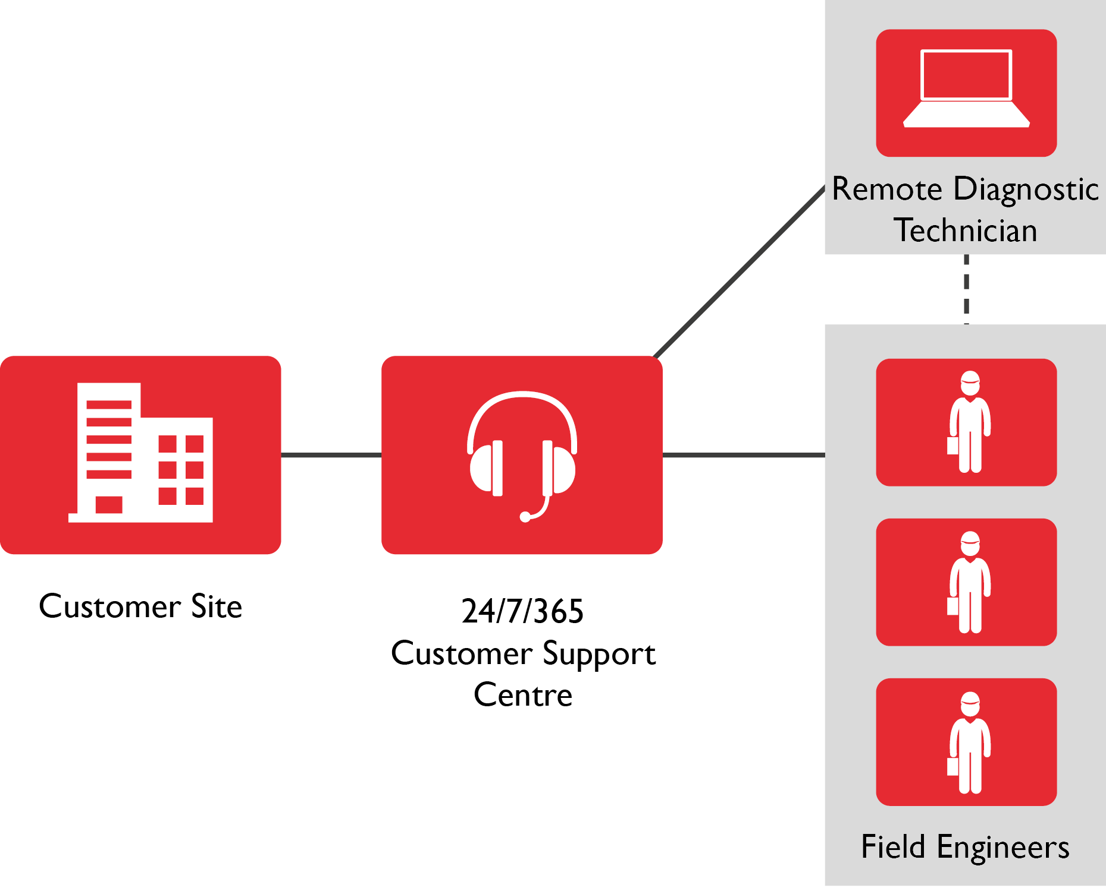
G4S Maintenance Support: How it Works …..

Slide 9
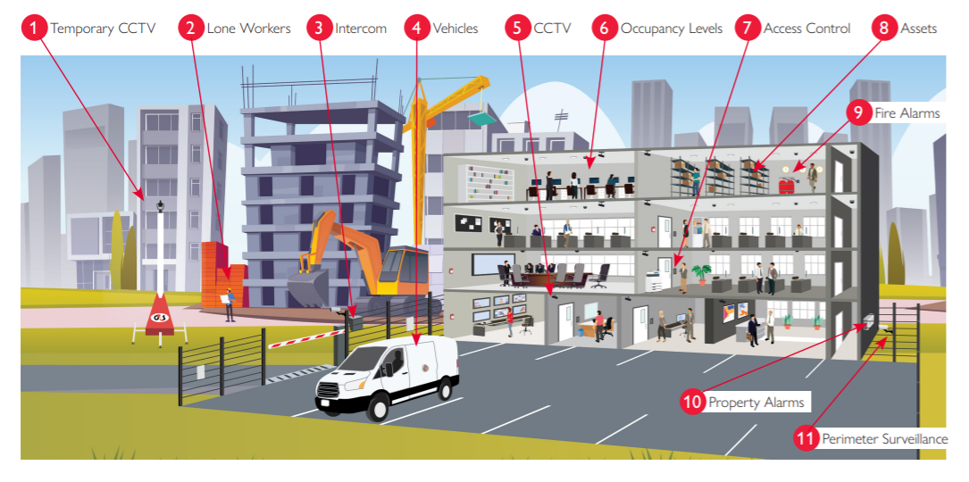
G4S Monitoring: What We Monitor

Slide 10
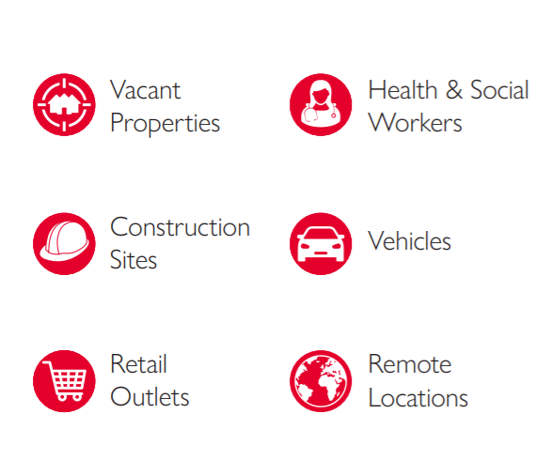






G4S Monitoring: Who We Monitor
Lone Worker
Facilities - Out Of Hours
Offices & Industrial Units
Critical Infrastructure
Temporary Facilities
Campuses

Slide 11
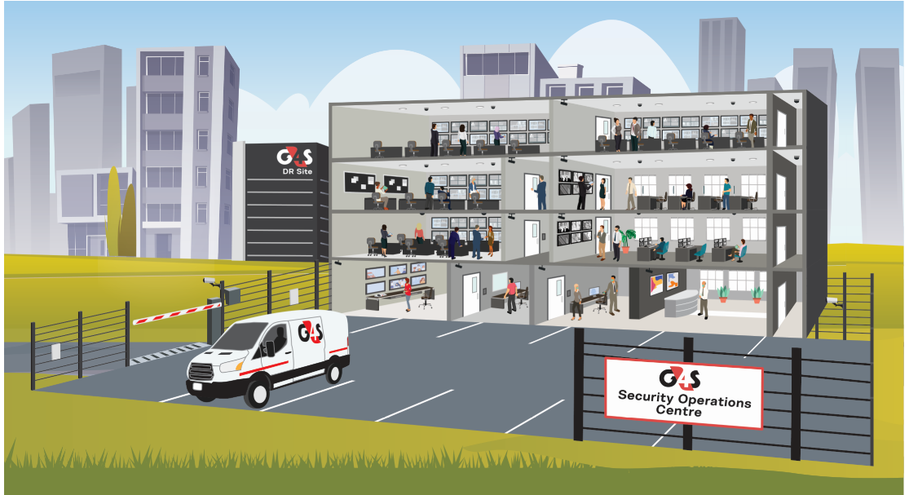
G4S Monitoring: Where We Monitor From
24 x 7 x 365 Belfast Facility
Fully Resilient With DR Site
64,000 Connections Monitored
Highly Accredited
Cat II NSI Gold Standard
BS5979
BS8484
IS228
Operating in Close Partnership with G4S Mobile Response Teams

Slide 12
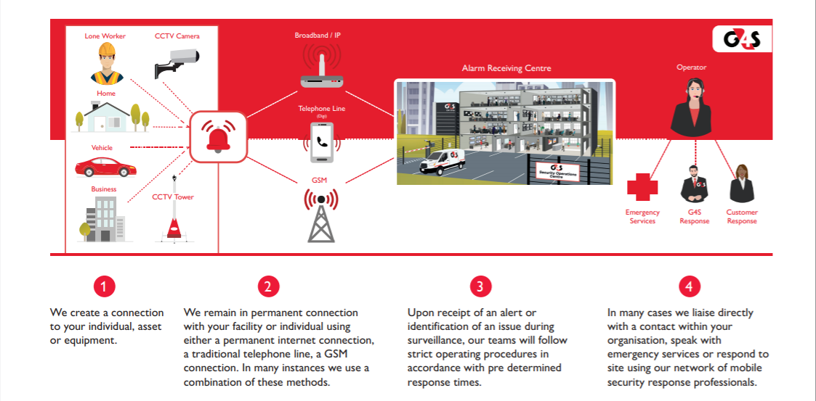
G4S Monitoring: How It Works

Slide 13
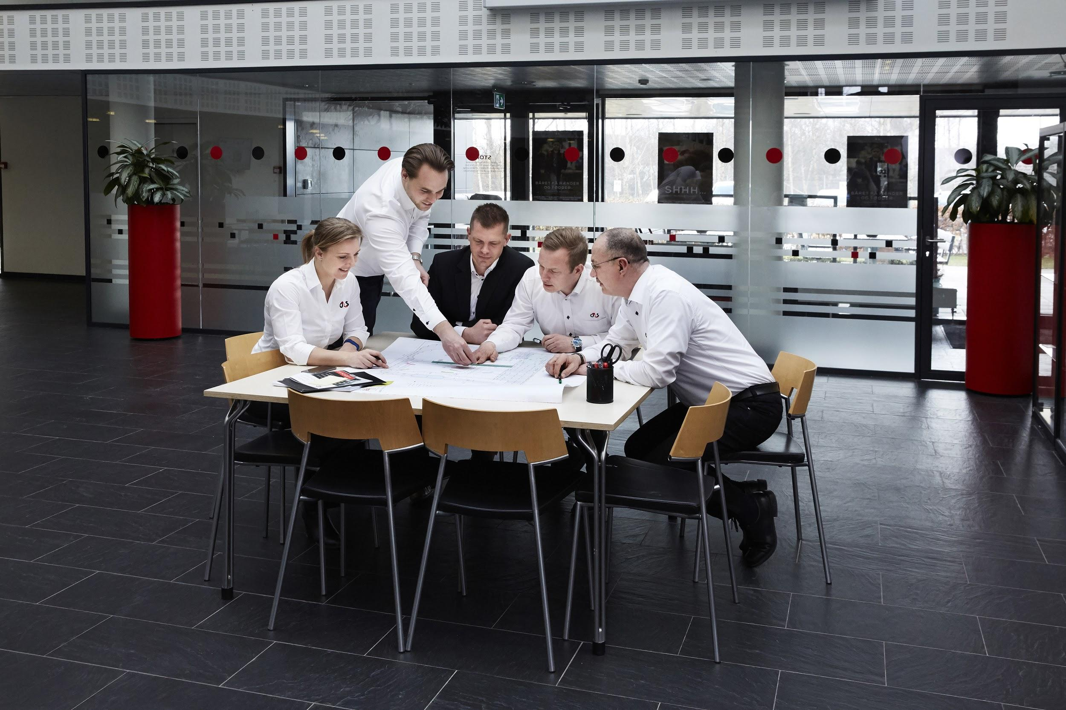

G4S ACADEMY
SLIDE HELP
TO CHANGE THIS BACKGROUND IMAGE:
RIGHT CLICK on background
Select CHANGE BACKGROUND > CHOOSE IMAGE
Select the image to use
Note: Images will need to be a ratio of 16x9 so as not to be distorted (Stretched or Squash).
You do not need to include all regional slides - use only what is applicable in your market.
Free MONTHLY SECURITY BULLETIN, NETWORKING & CPD
Repository of
PAPERS, WEBINARS & PODCASTS
Direct Access to
NETWORK OF SECURITY SPECIALISTS
Academy Link: https://www.g4s.com/en-gb/what-we-do/academy

