Slide 1

Please watch the presentation via the slide show feature to see the effects of explosion

Slide 2







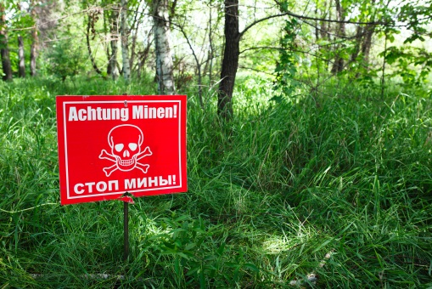


G4S Training & Consulting
Blast Modelling: Petrochem Industry Experience
September 2018 – Tim Brewer & Yannick De Smet (yannick.desmet@be.G4S.com)

Slide 3
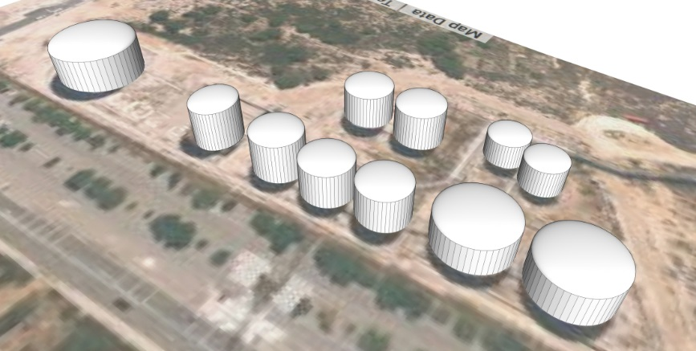
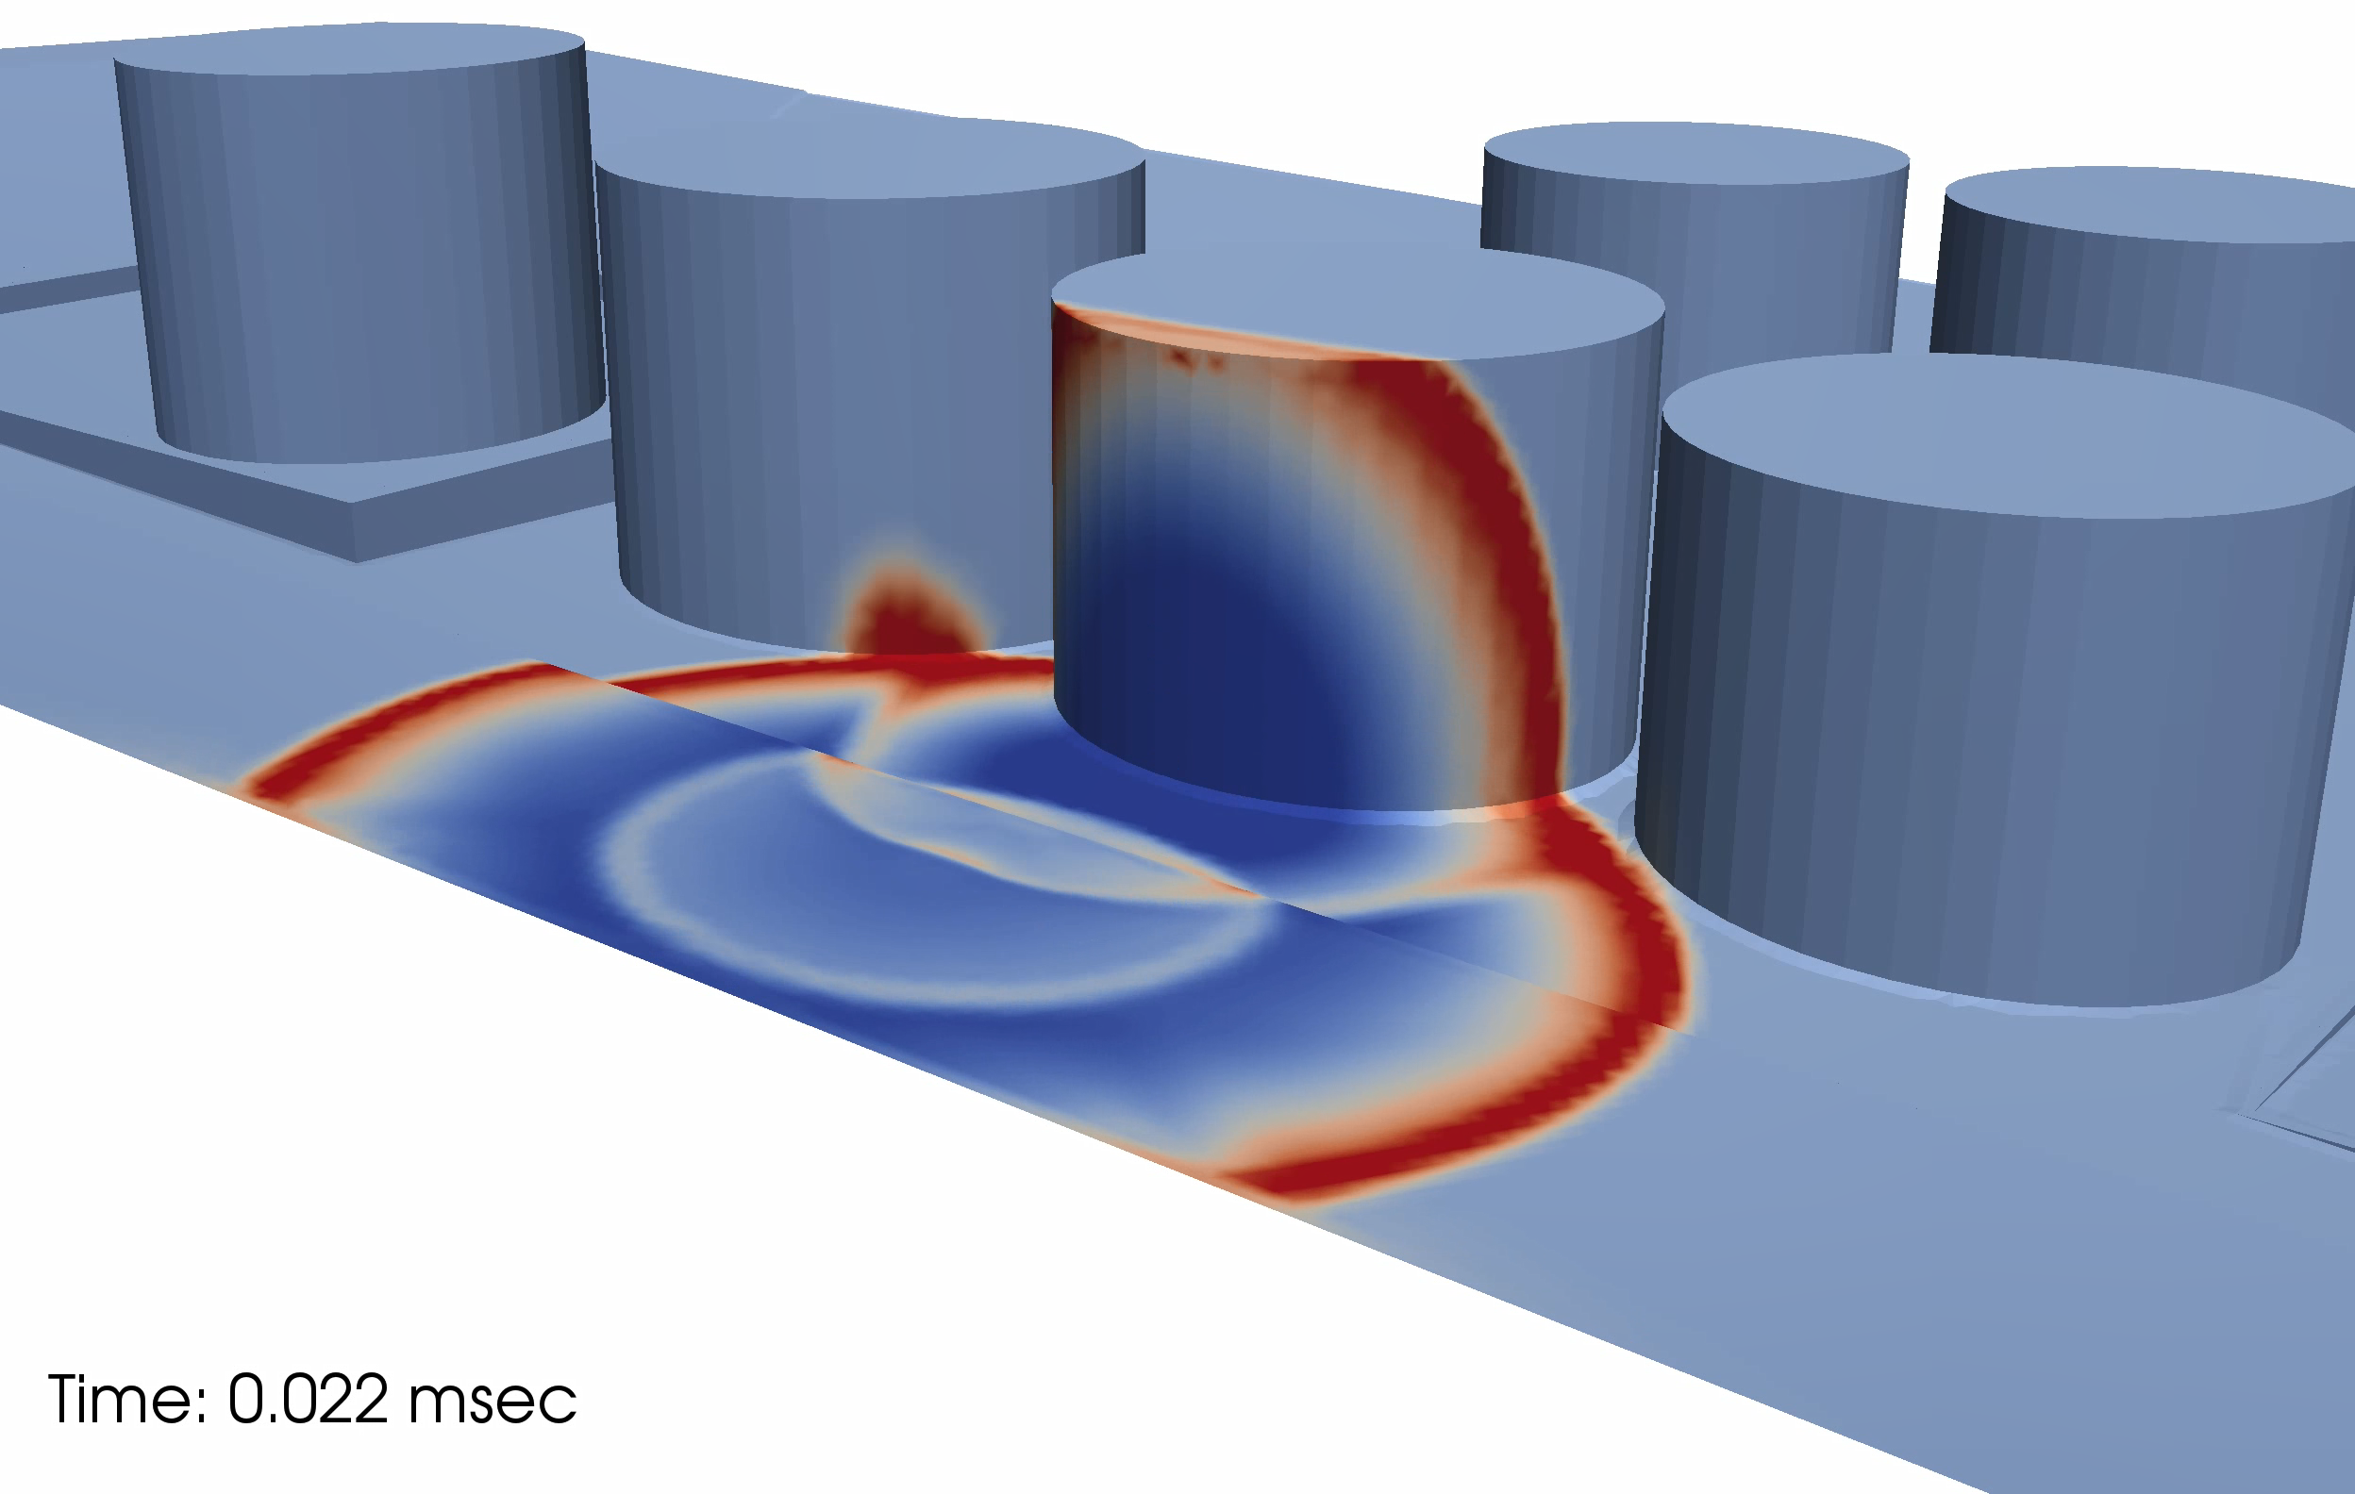
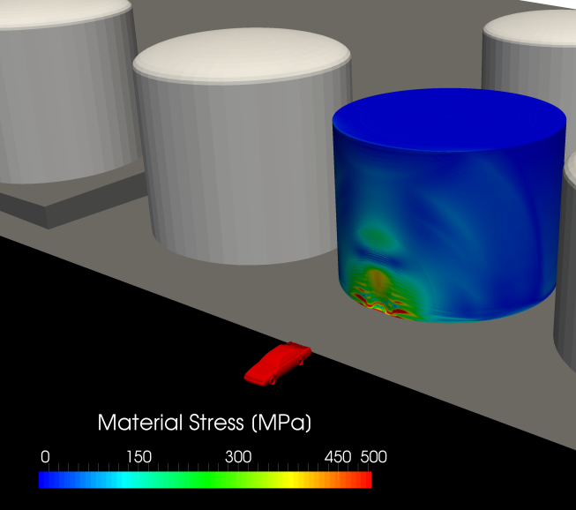
Explosive Threats – Far Field
VIDEO

Slide 4
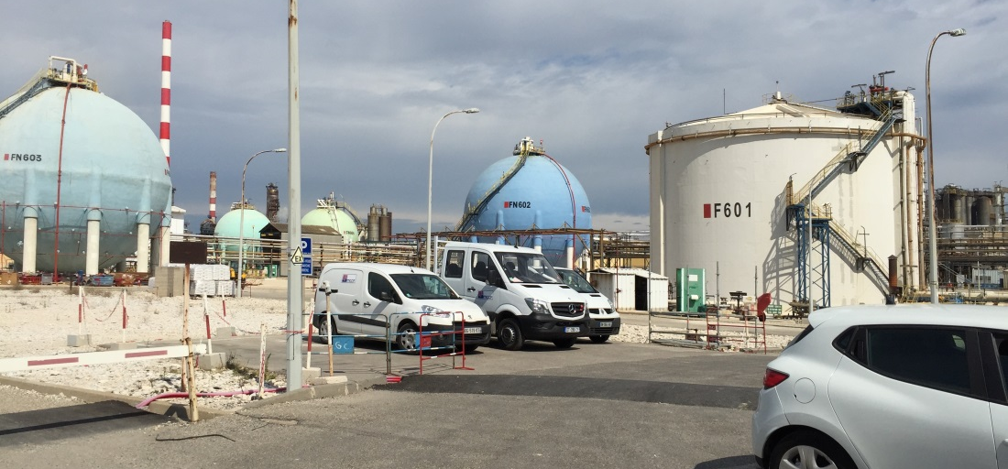
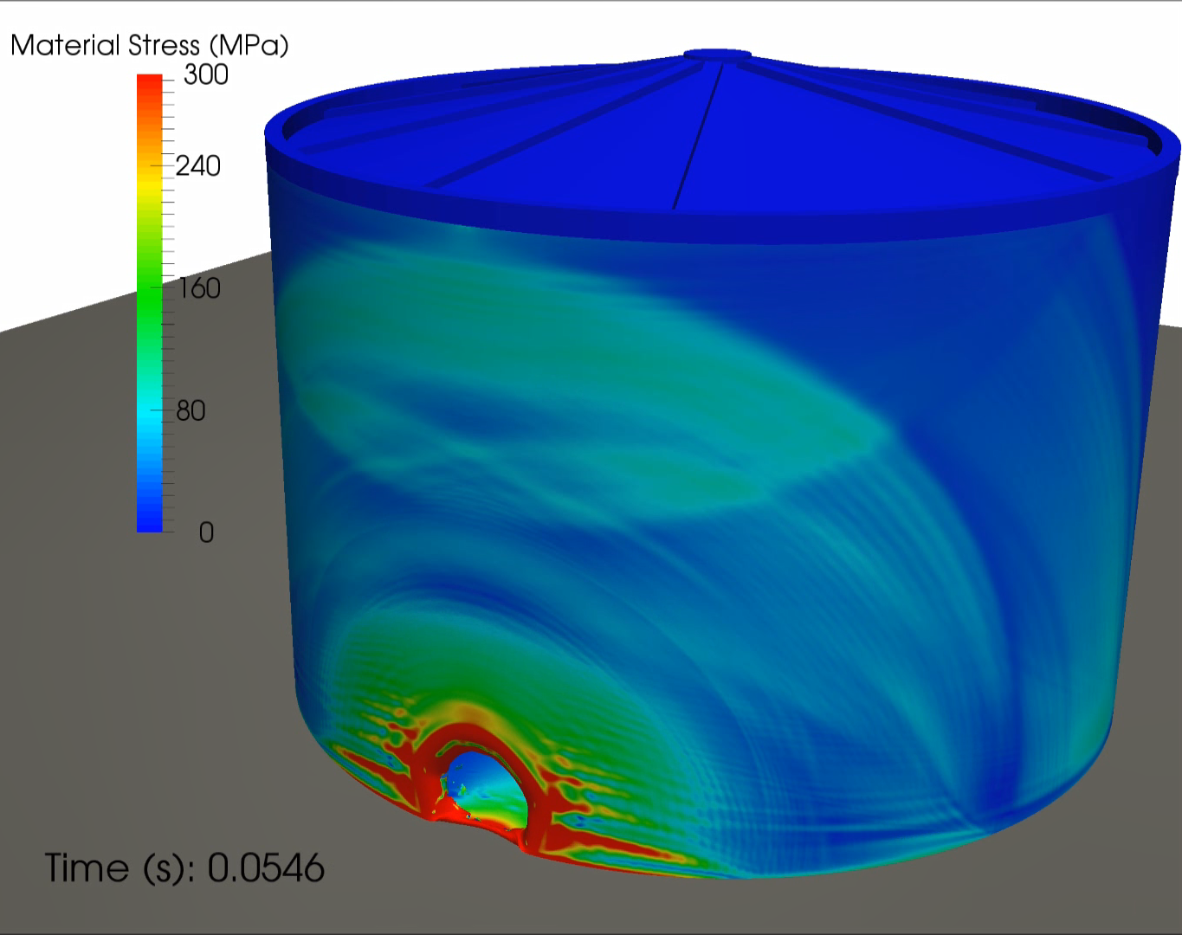
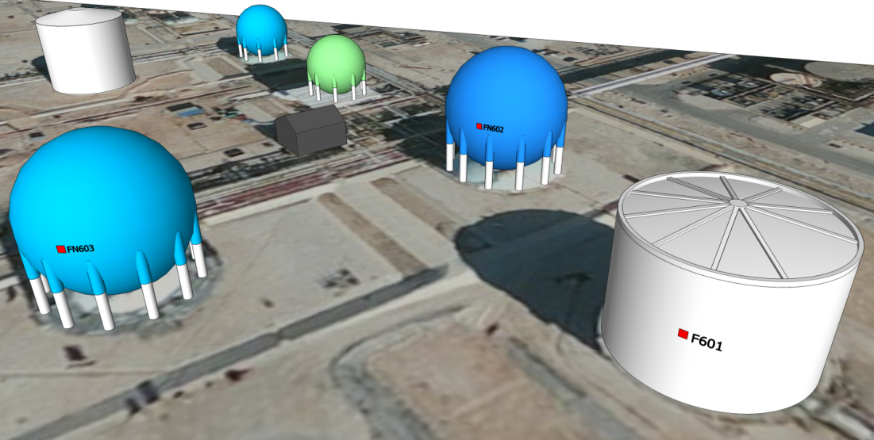
Explosive Threats – Near Contact
VIDEO

Slide 5
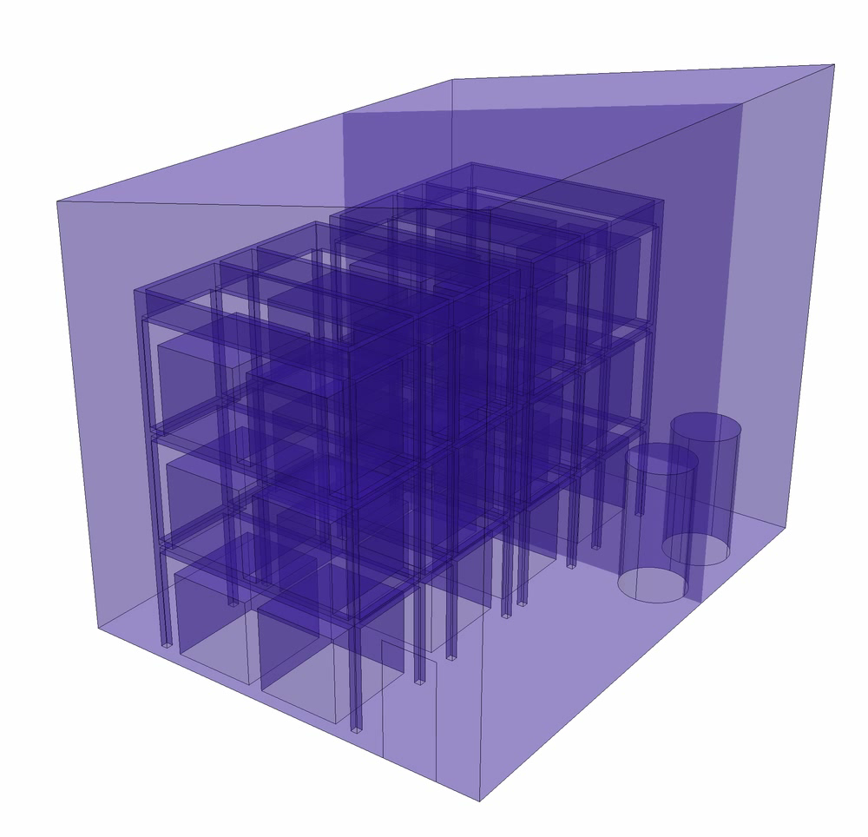
Dispersion & Deflagration Modeling
Boundary conditions (inlet, vent area, walls) and desired mesh refinement is set with CAD-integrated mesh generation toolkit
A chemical agent is assumed to leak rapidly from the top of a cylindrical vessel
Slow releases may also be considered over extended periods of time
HVAC, active/passive ventilation, wind, etc. may also be considered
Complex geometry and confinement is explicitly considered
VIDEO

Slide 6
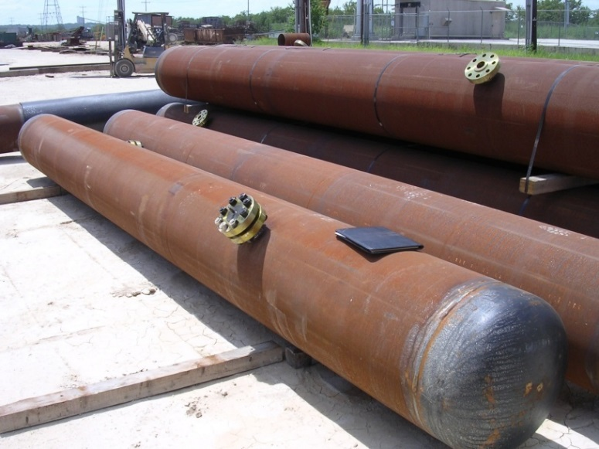
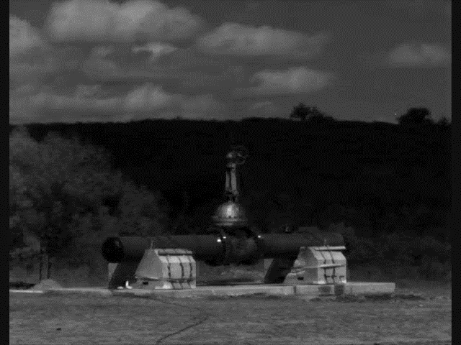
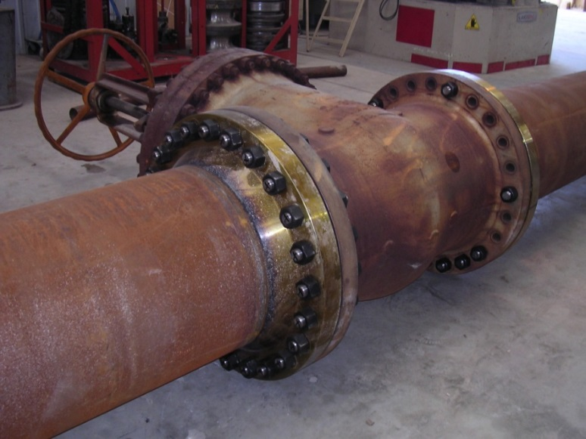
Pipelines & Explosive Threats
VIDEO
Experimental test program to investigate various pressurized pipeline protective systems to mitigate close-in/contact charge threats

Slide 7
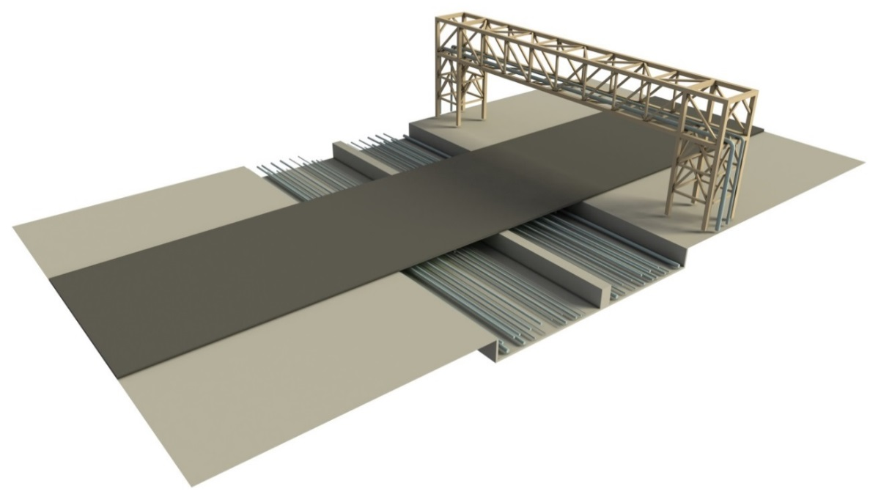
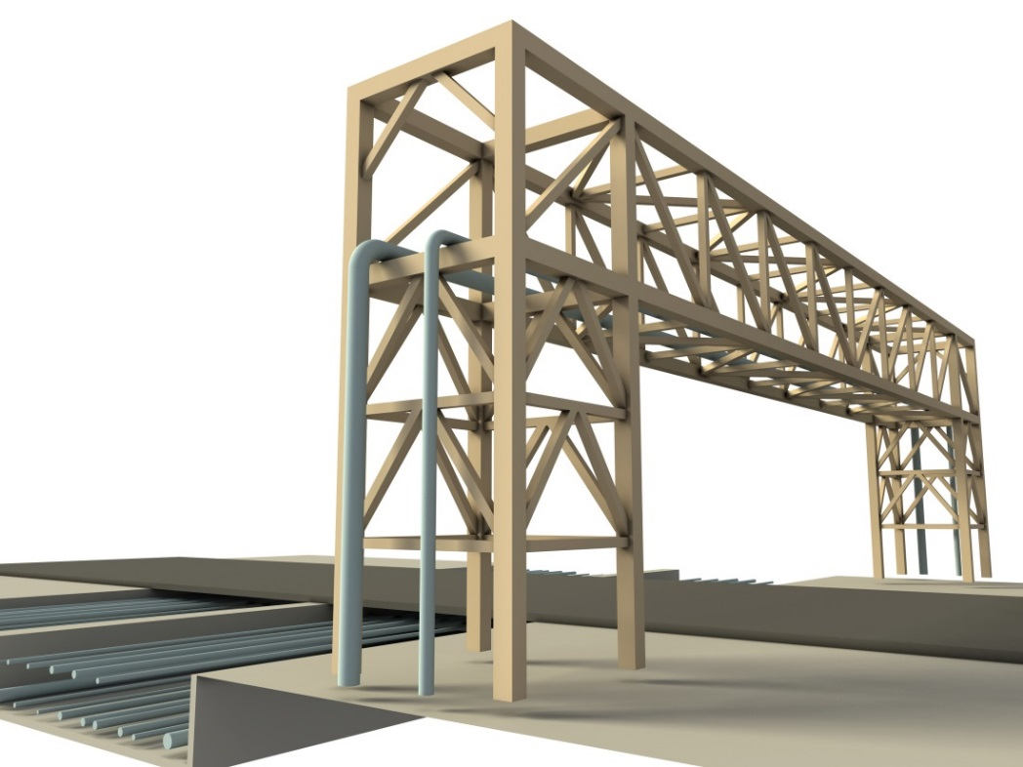
Pipeline Hazards
Development of a 3-dimensional model of the site, pipelines and supporting fixtures from available engineering drawings, technical information, site photos, and GIS data
Calculation of pipe material damage induced by impact events utilizing finite element methods to determine the extent of pipe breach, and the potential for an explosive event
Calculation of the equivalent explosive energy released by the pipe contents
Calculation of the overpressures resultant from the exploding pipe contents using Computational Fluid Dynamics (CFD) methods
Assessment of human and equipment vulnerability

Slide 8
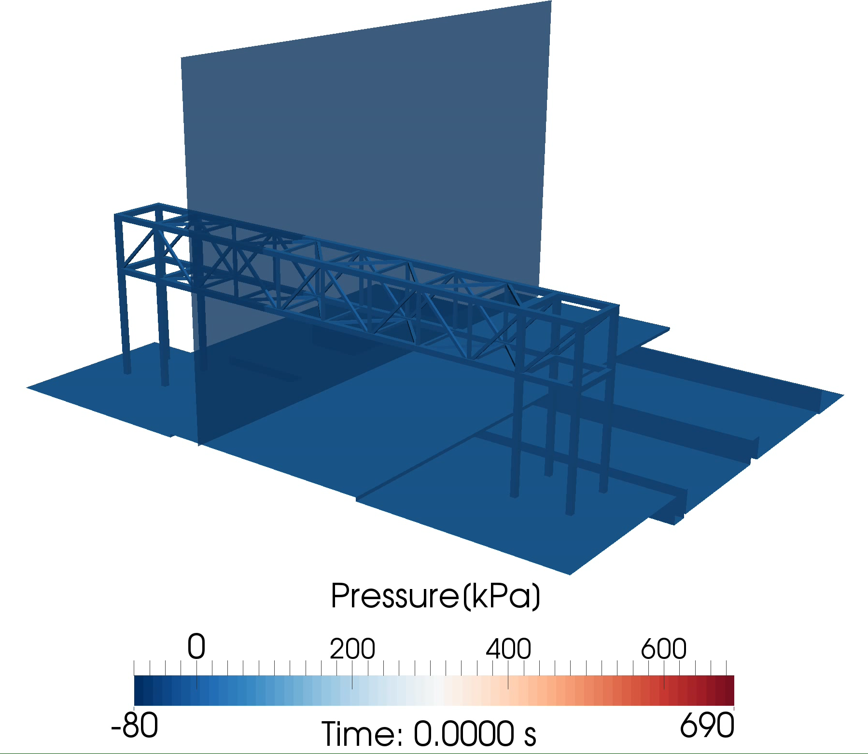
VIDEO: Pipeline Hazards
VIDEO

Slide 9
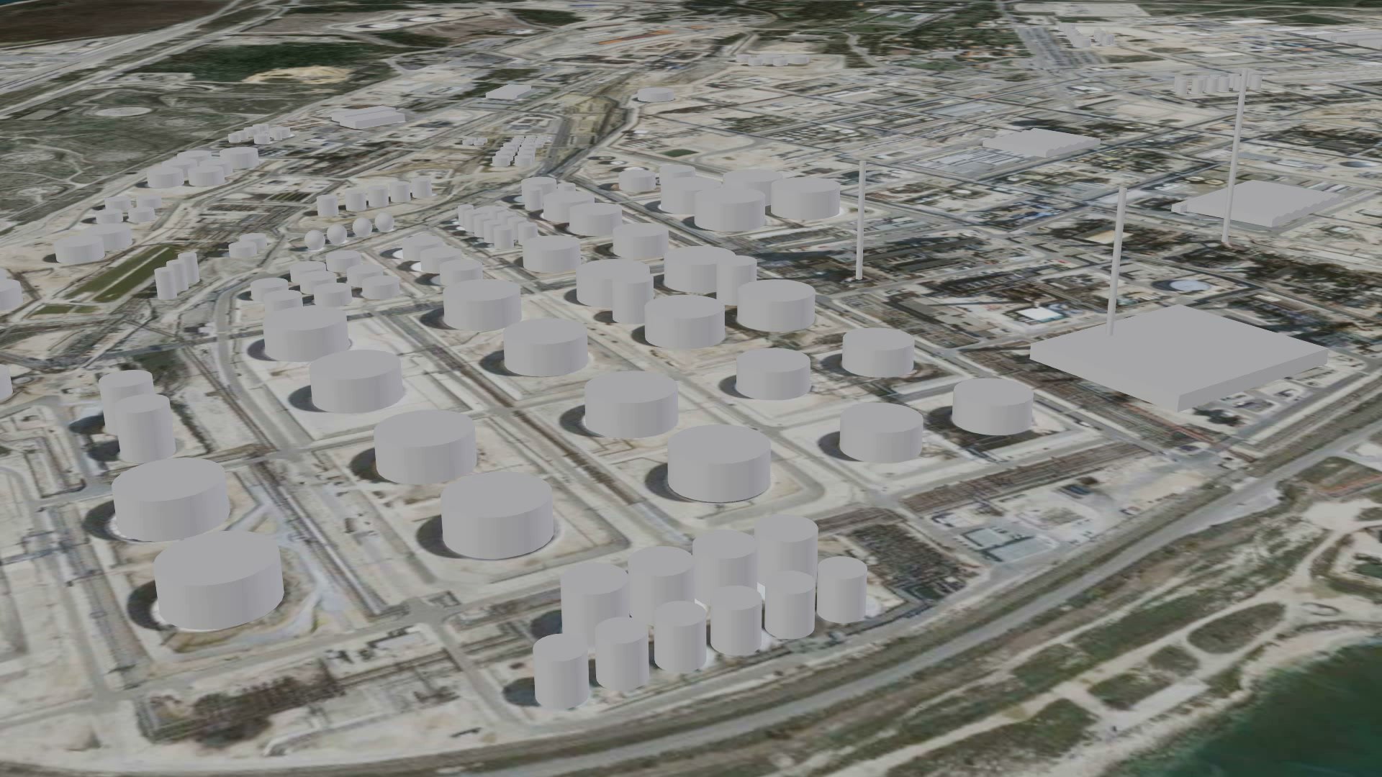
VIDEO
VIDEO: Fire, Thermal Effects, & Smoke
Calculate structural, equipment, & human vulnerability subject to a fire event;

Slide 10
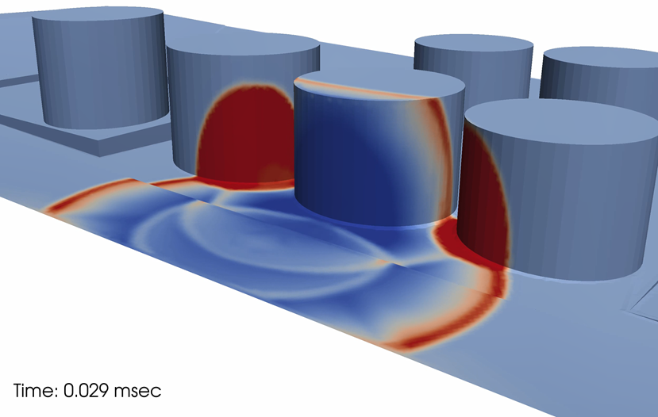
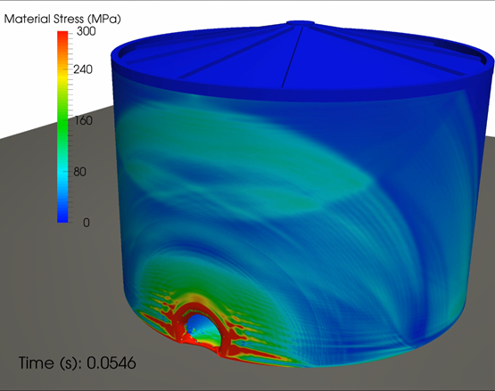
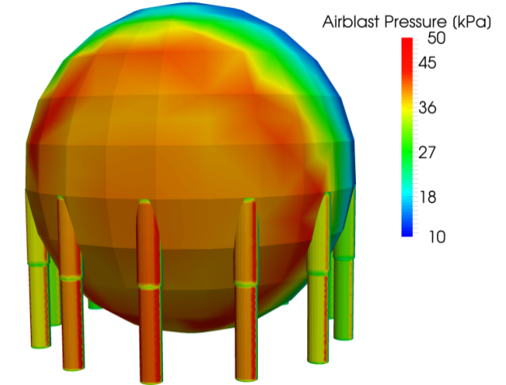

Vulnerability of Site Components to Explosive Threats

